Slide 1
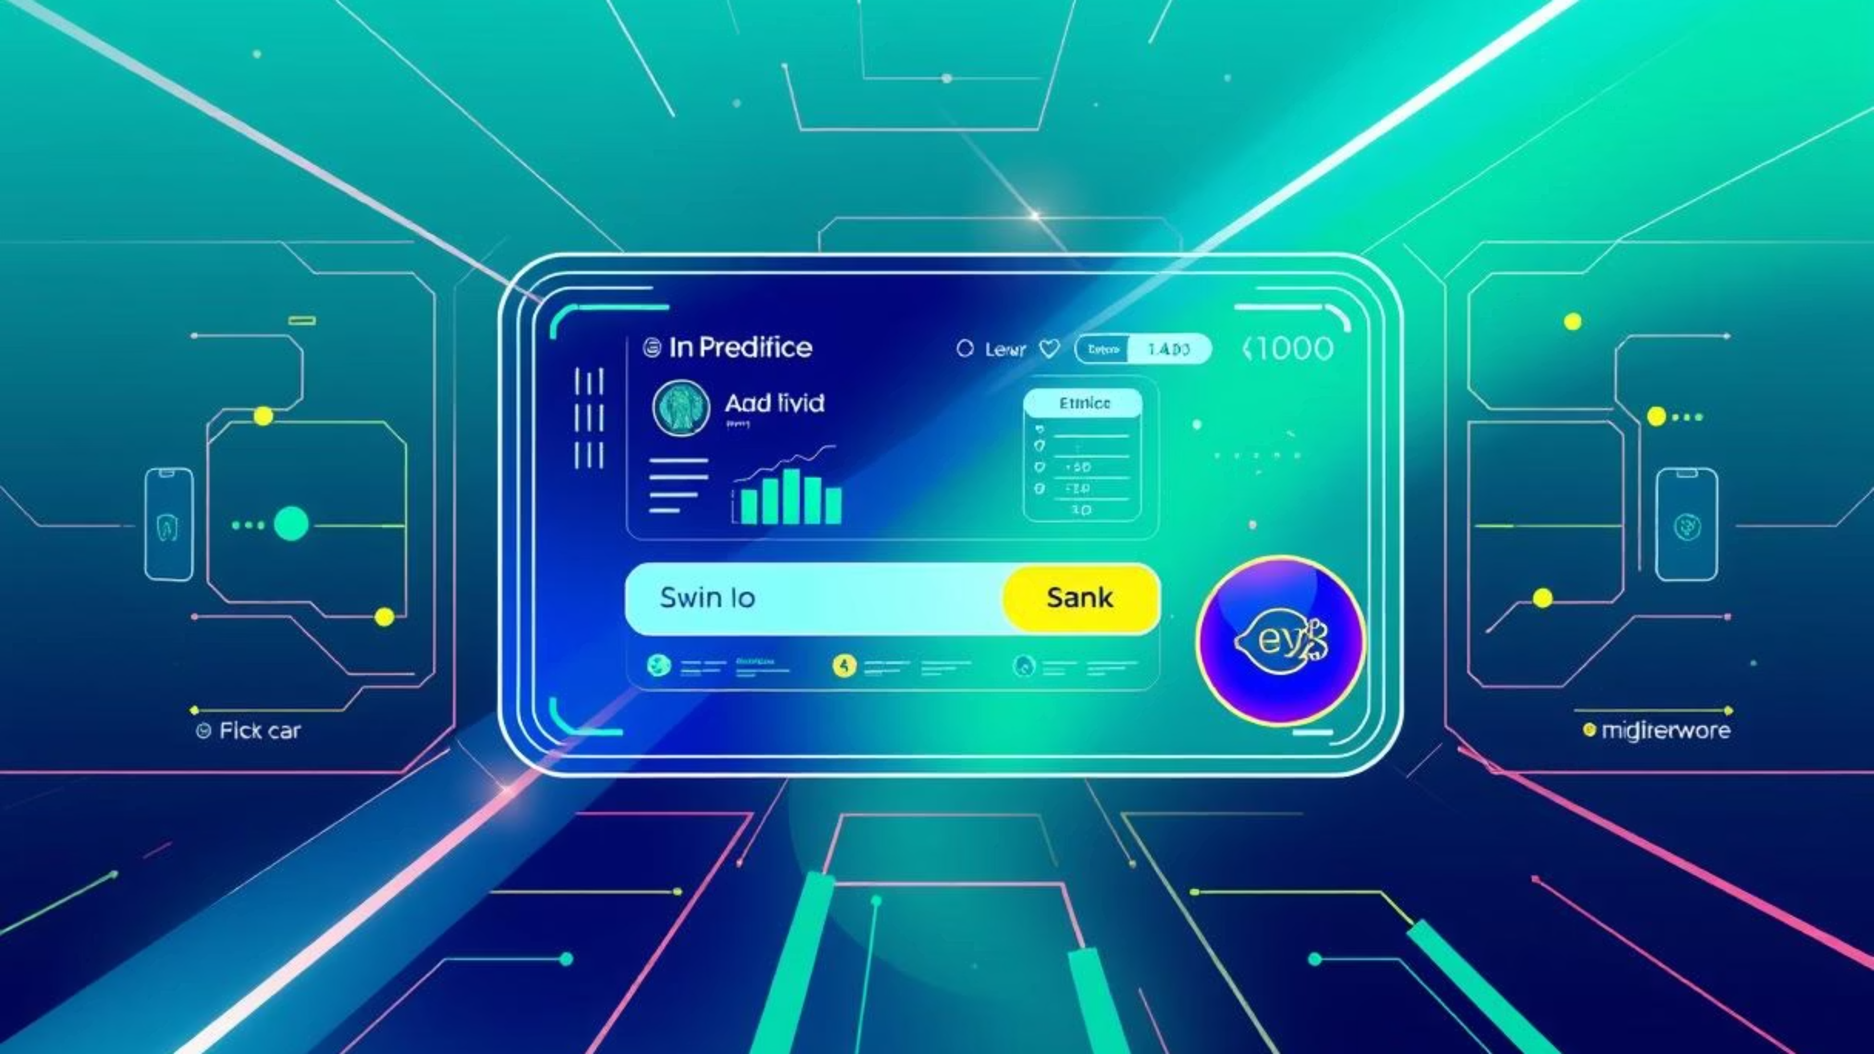

b
ba

Slide 2
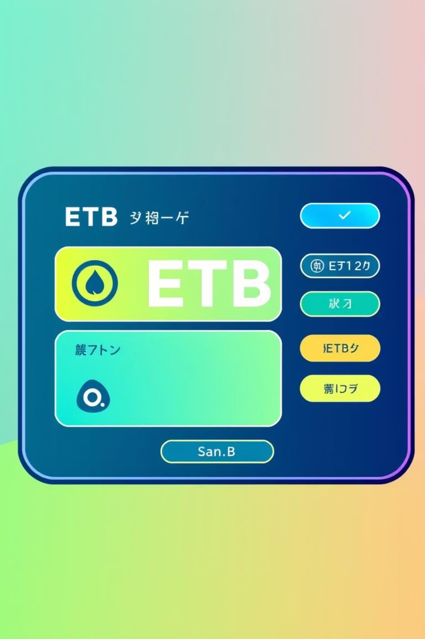

Introduction to Tobia Banking
The Tobia Banking System is a robust, Java-based desktop application designed to modernize banking operations. Financial institutions require secure, efficient, and user-friendly platforms to manage customers and transactions. This system bridges the gap between traditional banking and digital convenience, offering tailored features for the Ethiopian market, including specific bill payments and ETB currency integration.
Modern Banking
Robust Java-based desktop application.
Secure & Efficient
Manages customers and transactions securely.
Ethiopian Context
Tailored features for the local market.

Slide 3
Project Objectives
1
2
3
Digital Transformation
Enhanced Security
Accessibility
Automate manual processes like account creation, and record-keeping.
Provide a secure environment with role-based authentication (Admin vs. Customer).
Allow remote banking tasks (transfers, bill payments) without branch visits.
4
5
Real-Time Information
Localization
Deliver up-to-date financial data, including live currency exchange rates.
Integrate with local utility providers (EEU, Ethio Telecom).

Slide 4
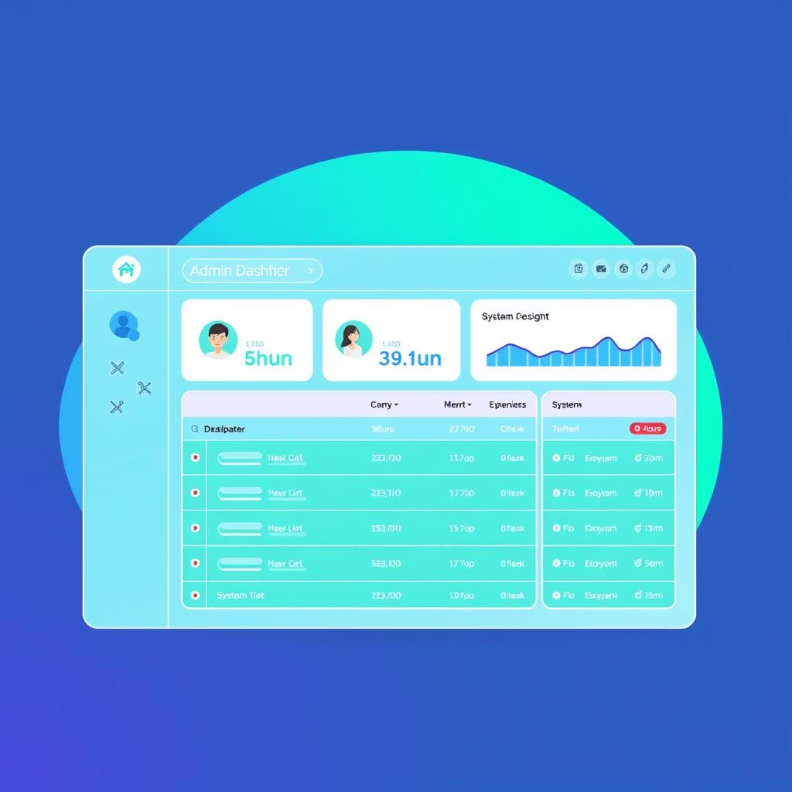
Scope of the Project: Admin Module
Comprehensive Control
The Admin Module provides full control over user and account management, ensuring efficient system oversight.
Full control over user management (Register, Update, Delete customers).
Account management (Opening/Closing accounts).
System monitoring via logs and dashboards.

Slide 5
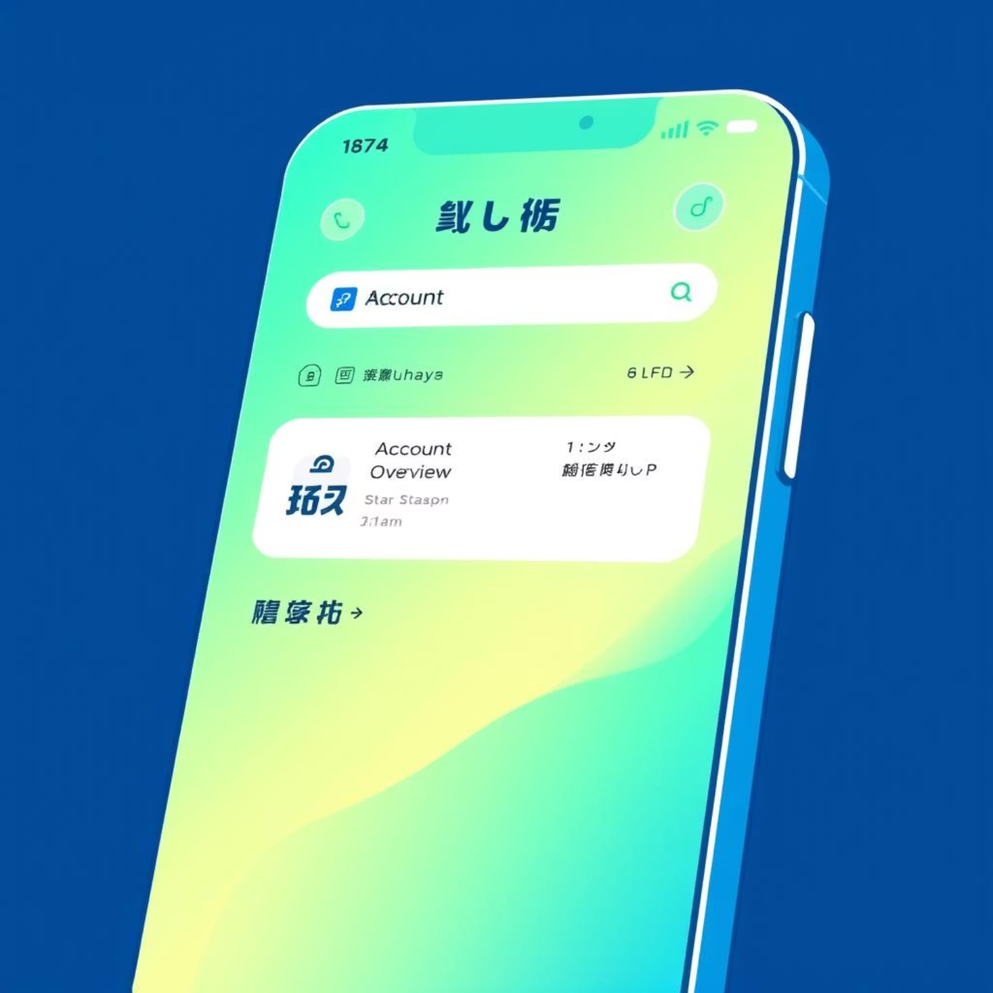
Scope of the Project: Customer Module
Empowering Customers
The Customer Module offers a personalized and convenient banking experience, allowing users to manage their finances remotely.
Personal dashboard for account overview.
Fund transfers (Internal and Inter-bank).
Utility bill payments.
Transaction history and balance inquiries.

Slide 6
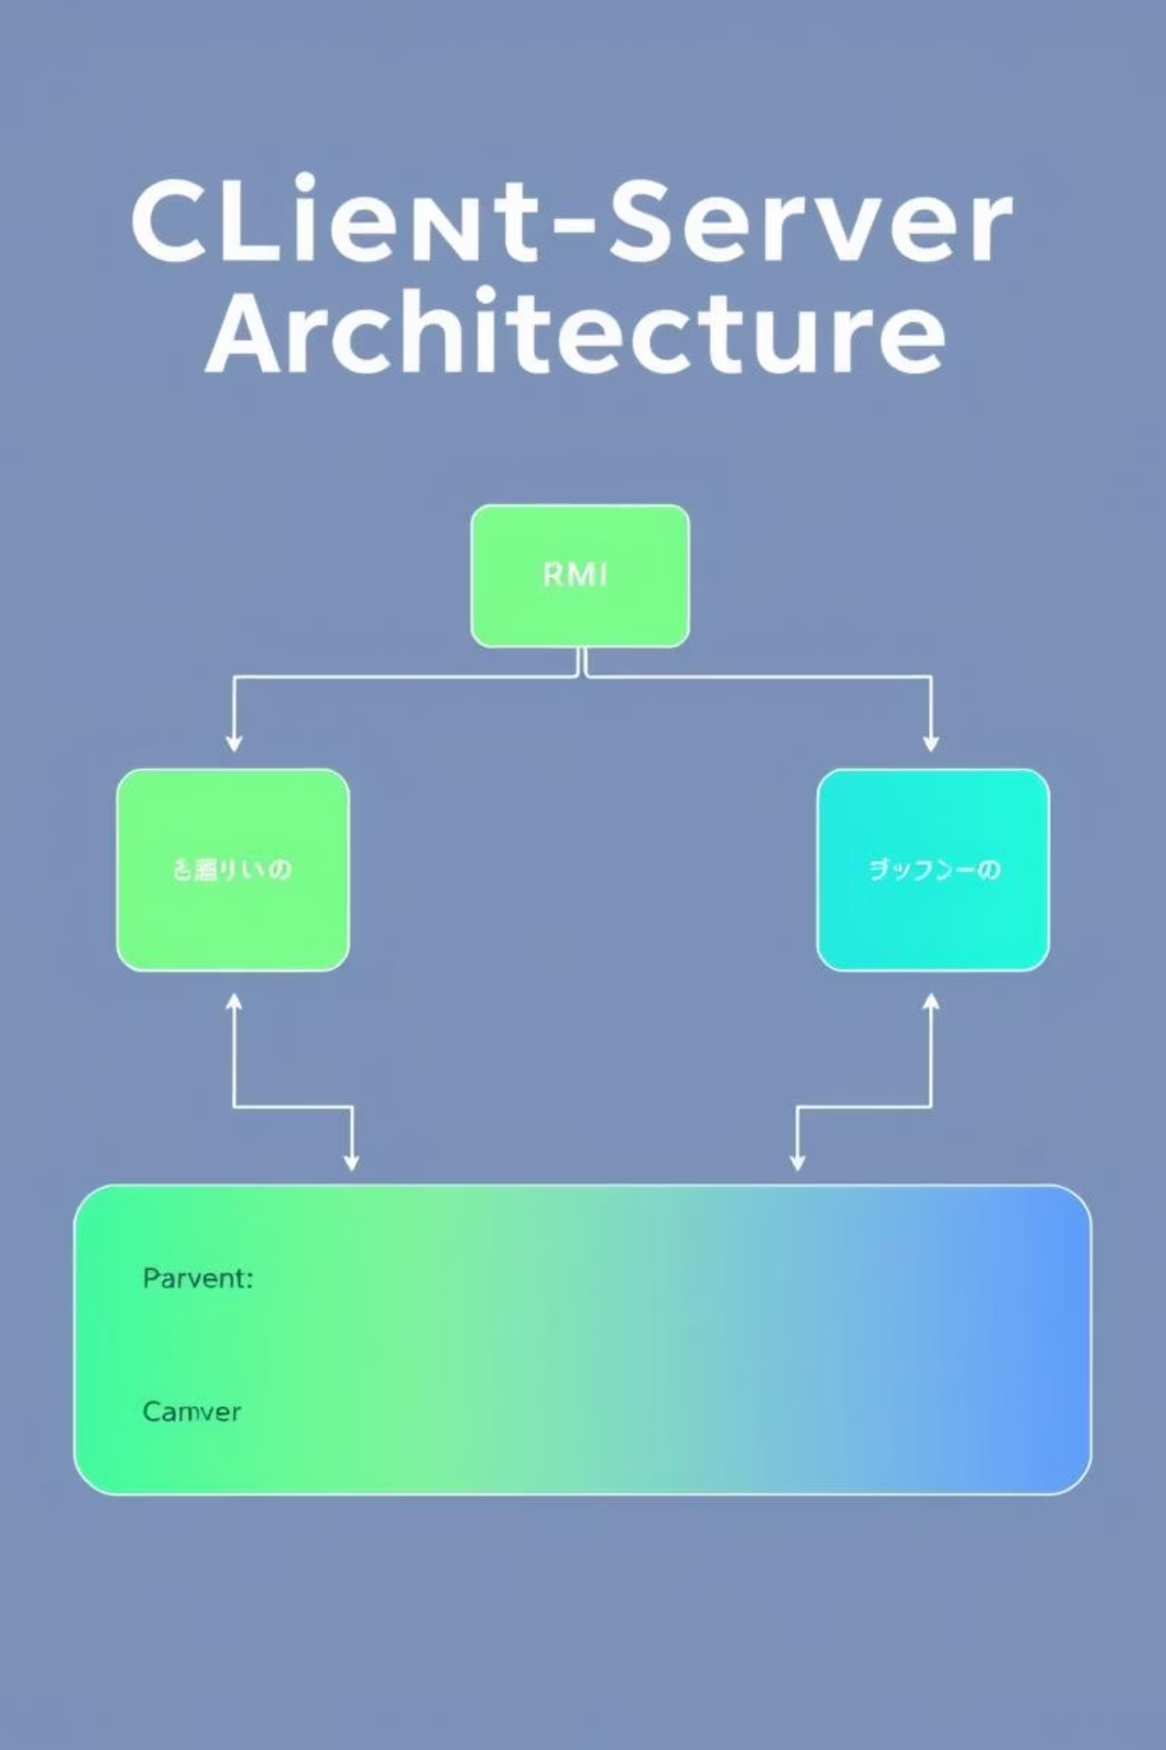



Technical Architecture: Client-Server & MVC
The Tobia Banking System leverages a robust technical architecture to ensure secure and efficient operations.
Client-Server
Java RMI for secure client-server communication.
MVC Pattern
Model, View, Controller for structured development.
Data Handling
Gson Library for JSON parsing; Multithreading for UI responsiveness.

Slide 7
Key Functionalities
Authentication
Transaction Engine
Secure login with role detection and password management.
Validates balances and supports "Real Mobile Banking" constraints.
Dynamic Reporting
Live Currency
Visual charts for user demographics and account types.
Fetches live rates (e.g., USD to ETB) and includes a calculator.

Slide 8
Advantages of Tobia Banking
User-Centric Design
Localized Features
Efficiency
Modern sidebar navigation and intuitive layouts for ease of use.
Designed for the Ethiopian context, including ETB currency and local billers.
Reduces teller workload by enabling customer self-service for routine tasks.
Reliability
Scalability
Robust error handling ensures system stability and data integrity.
Modular code structure allows for easy addition of new features.

Slide 9
Limitations
While robust, the Tobia Banking System has certain limitations that are important to consider for future development.
Platform Dependency
Network Reliance
Hardware Requirements
Currently a desktop application (JavaFX), requiring PC installation.
Requires active internet for RMI communication and live exchange rates.
Client machines must support the Java Runtime Environment (JRE).

Slide 10
Future Outlook
The Tobia Banking System lays a strong foundation for digital banking in Ethiopia. Future enhancements could include mobile application development, offline capabilities, and expanded integration with more local services.
We envision a future where banking is accessible, secure, and tailored to every individual's needs, driving financial inclusion and economic growth.

Slide 11
Notes:
thank you

